Slide 1
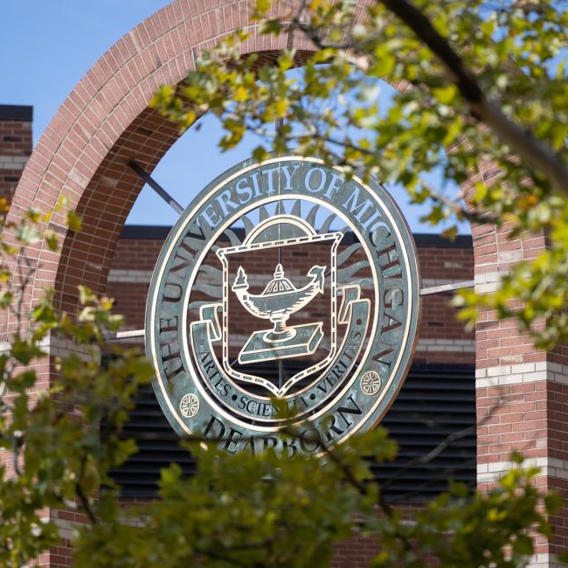
EXPERIMENT PLAN FOR ROEMOTION
Deniz k acikbas
04/06/2025

Slide 2
Absence of Existing Academic Papers
Currently, there is no research paper that links emotion with arm or wrist movement.
The nearest study from NIH connects handwriting to emotions. (This paper can be made available upon request).
Training in Machine Learning
In the next phase, we will gather data for each emotional category based on how we correlate emotions with the patterns produced by the LED wristband in relation to wrist movement.
After sufficient data is gathered, we will proceed to train the machine learning model.
Reasons for conducting an experiment

Slide 3
Outline of the Experiment
Phase 1: Linking Wrist Movement to Emotions
Experiment Process
Analyzing the data
Phase 2: Training the Machine Learning Model
Planning the deep learning model (LSTM, CNN, ResNet, etc.)
Deciding on the number of samples needed for training the ML model.
Collecting data for the ML model.
Training the ML model
Integrating with the Xemotion

Slide 4
Phase 1
Linking Wrist Movement to Emotions

Slide 5
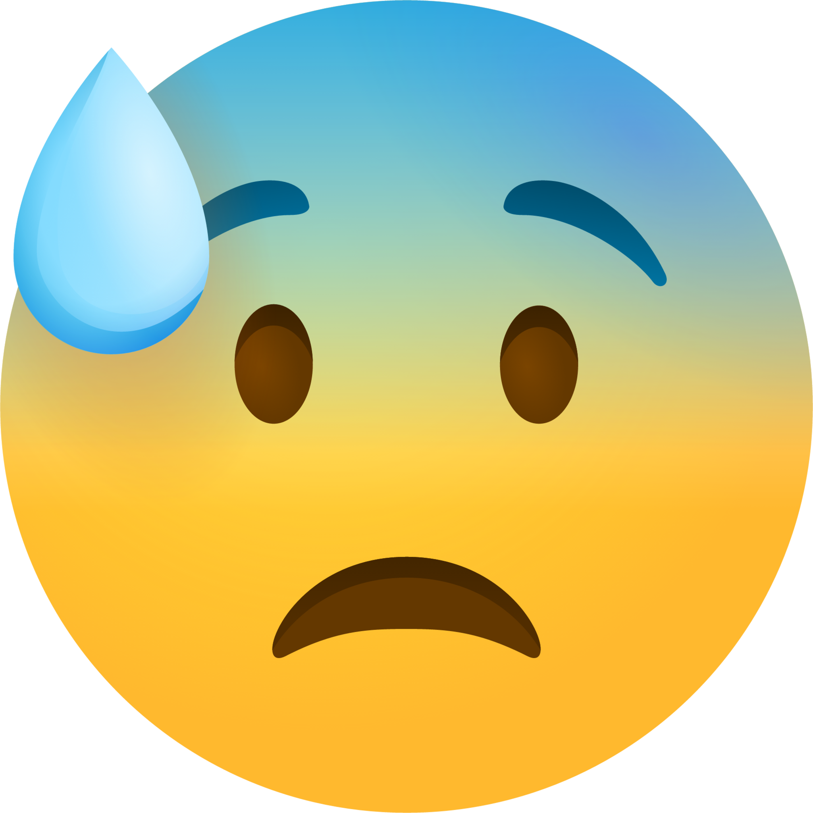


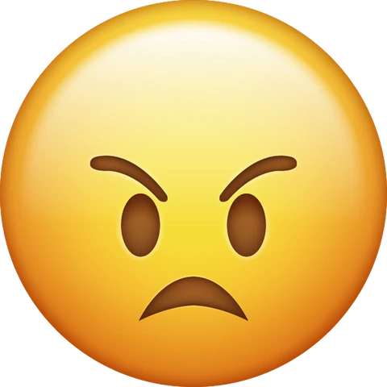
Experiment Process – List of Emotions
Happy
Sad
Angry
Anxious
Figure 1

Slide 6

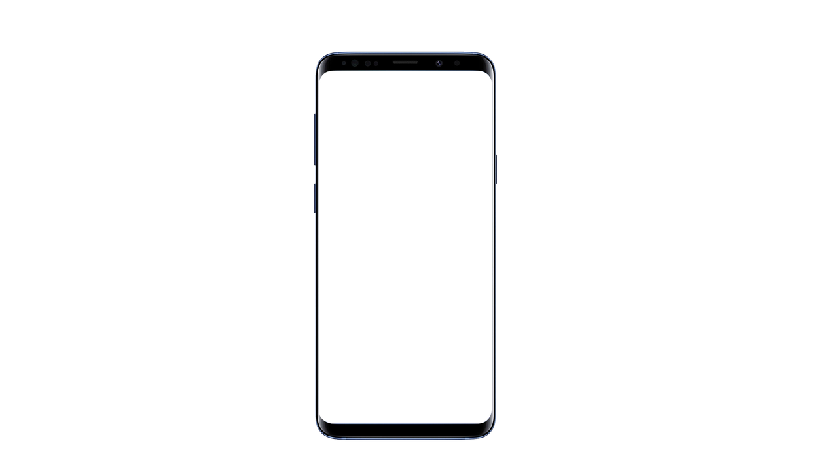
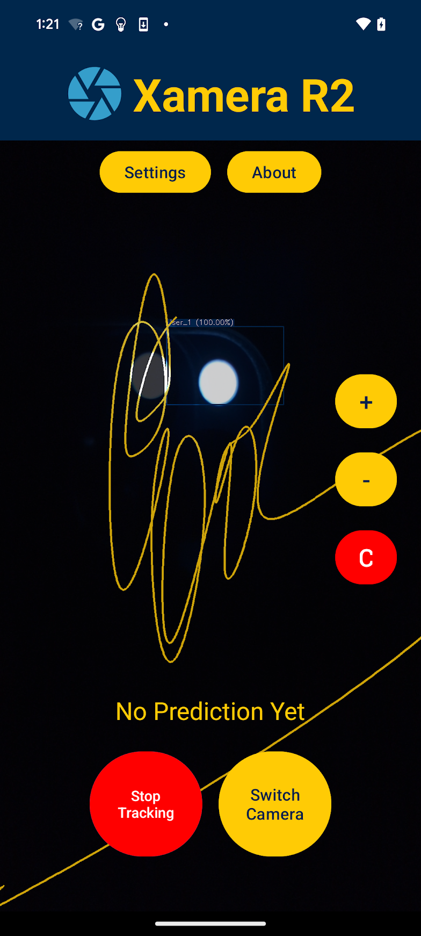
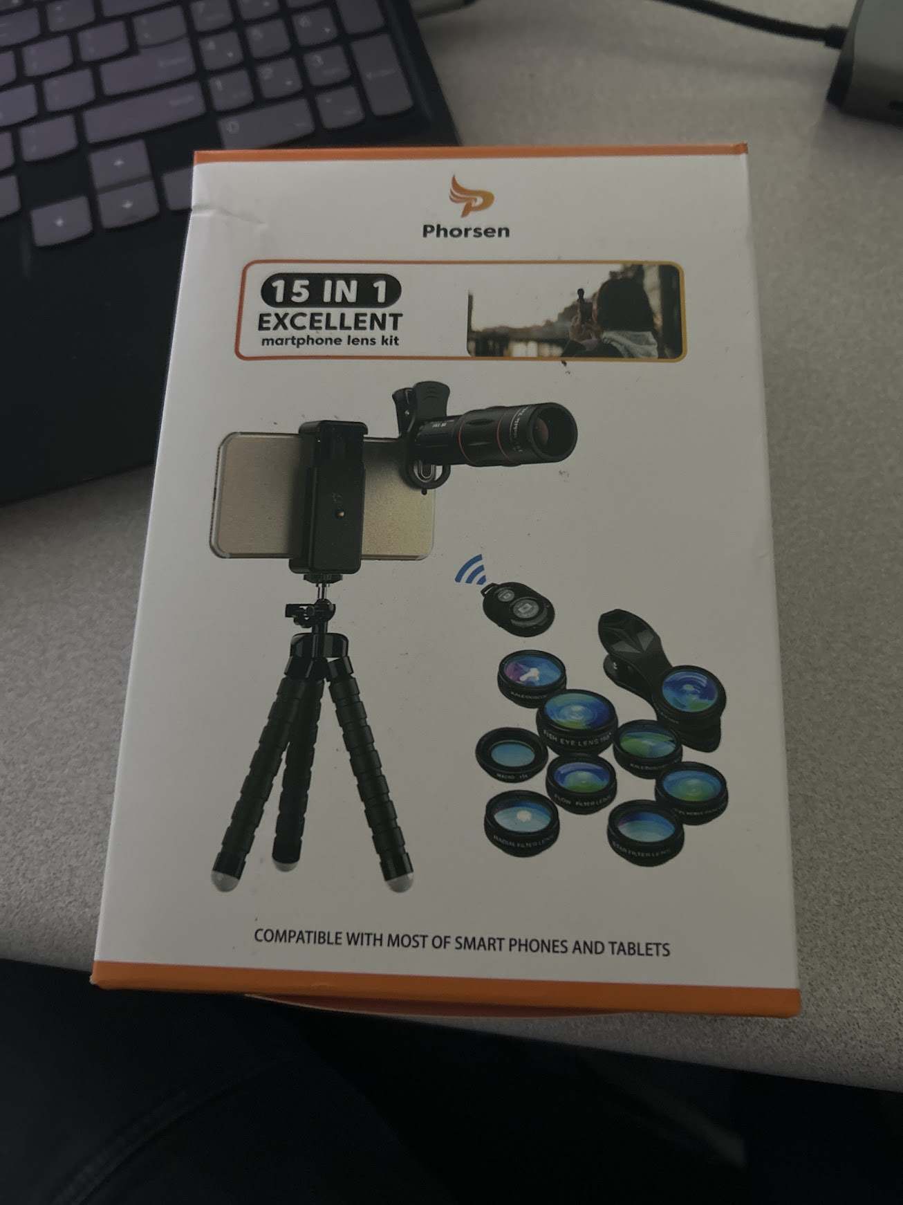

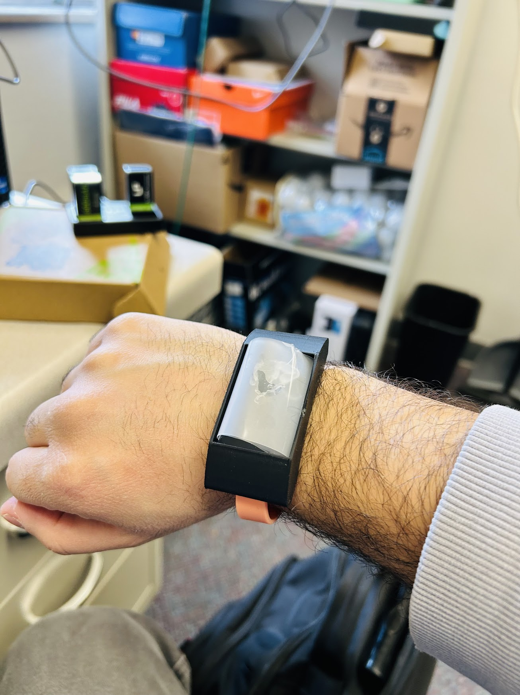
Experiment Process - Materials
Computer with Internet Connection
Xemotion Compatible Phone
Zooming Lens
LED Wristband
Figure 2

Slide 7
Seat the user at a desk, ensuring their hands remain visible to Xemotion.
Ensure that the user is mentally ready to focus on the video clip.
Activate the LED Wristband.
Choose and play a video clip from YouTube or a Netflix series that generates strong emotions.
Launch Xemotion, set the rolling shutter effect, and adjust the zoom to effectively capture the movements of the LED wristband within the frame.
Initiate the tracking process using Xemotion.
Track throughout the entire duration of the clip.
Once tracking is complete, Xemotion will automatically export the lines as a jpg file.
Experiment Process - Instructions

Slide 8
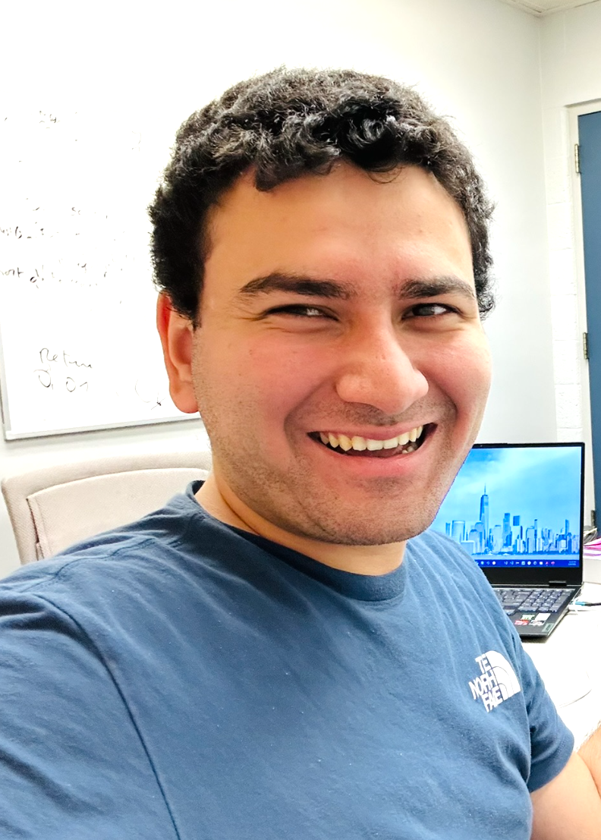
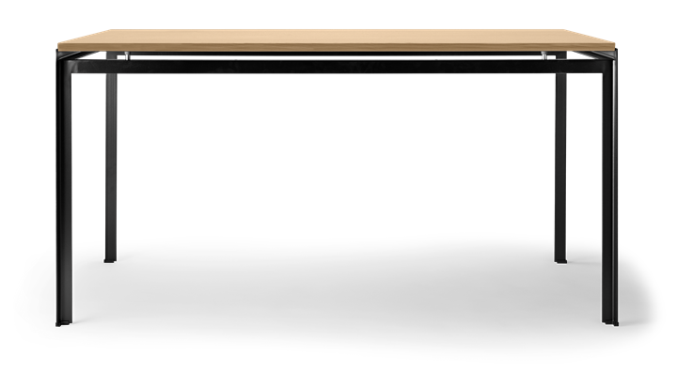

The viewer experiences feelings while watching the clips.
Scenes from a film that evoke strong feelings
The LED wristband is activated.
Exported Image
Excited
Xemotion generates lines as the user watches a film,
responding to their wrist movements.
ML Inference Result

Slide 9
Once the tracking is finished, ask the user to express their feelings about the scene by summarising it in one word, such as "Joyful," "Melancholic," or "Nervous."
Transfer the data from the smartphone to the computer and organise the jpg files into folders according to the emotion indicated by the user.
Collect as much data as you can to ensure that whenever the user experiences these emotions, they can generate similar lines.
After assembling the dataset, create a document that outlines the lines associated with each emotion.
Prepare a presentation highlighting the main points.
Analyzing the data - Instructions

Slide 10
Phase 2
Training the Machine Learning Model

Slide 11


Slide 12

Q & A THANK YOU
Lab: Room 108, CIS
Email: dacikbas@umich.edu
Website: developer27.com

